Slide 1

AI & Machine Learning in Robotics
Made by Jael McBride

Slide 2
What is AI
“AI is a machine that can exceed or be equal to the intelligence or capability of a person”
Discover
Infer
Reason

Slide 3






Pen Pineapple Apple Pen

Slide 4
What is AI compared to ML
AI vs ML
Does AI = ML
IS AI Different than ML

Slide 5
AI Compared ML
AI
A superset
Contains many forms of computing
As capable or more capable than a human
Machine Learning
Specific set (Narrow focus)
A single subset of computing
Human presented data-reliant

Slide 6
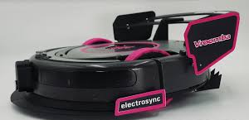
Autonomous Work
AI and ML are used in automated tasks like a Roomba mapping and cleaning a room.

Slide 7
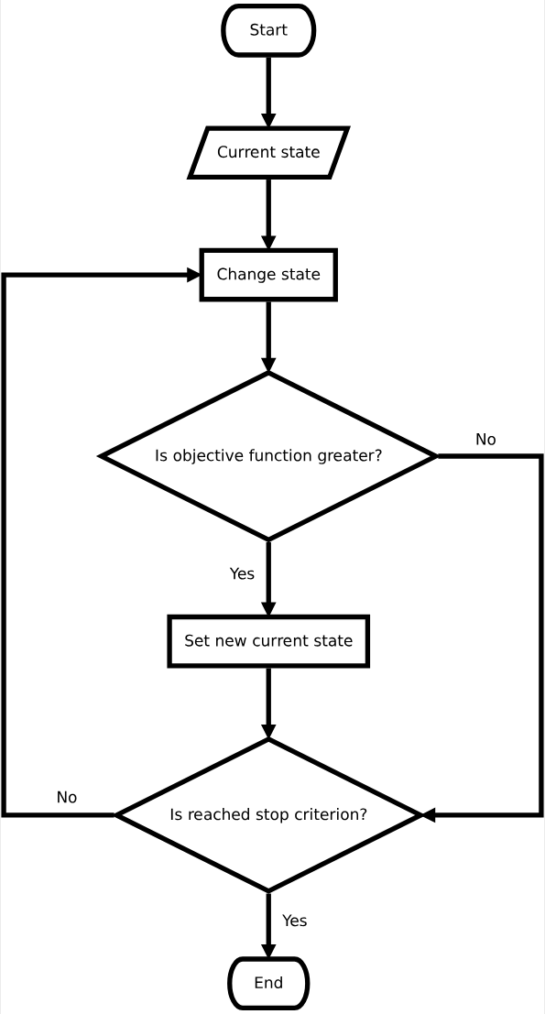
Hill Climber Algorithm
Trial and Error
Task correction
Self-optimization

Slide 8

Prioritizing tasks
The ability to specifically choose the most important task/mission to be done

Slide 9
Rank to Rank Learning Rank

Slide 10
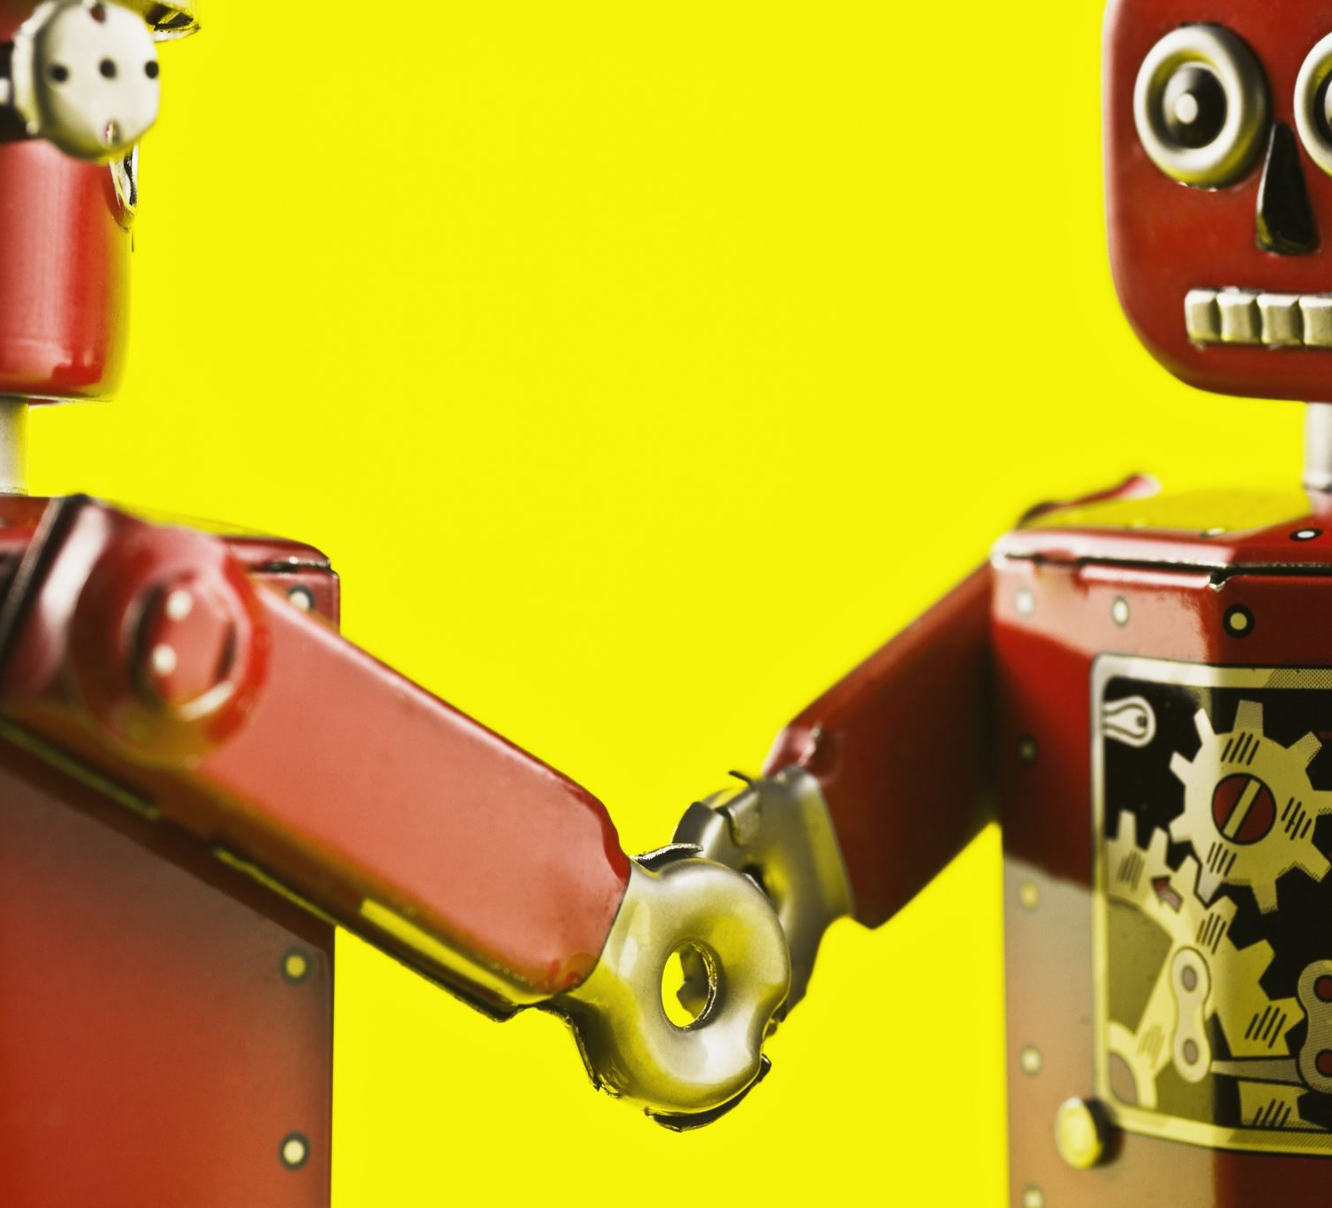
Object recognition
If the machine can see, then the machine can chase

Slide 11
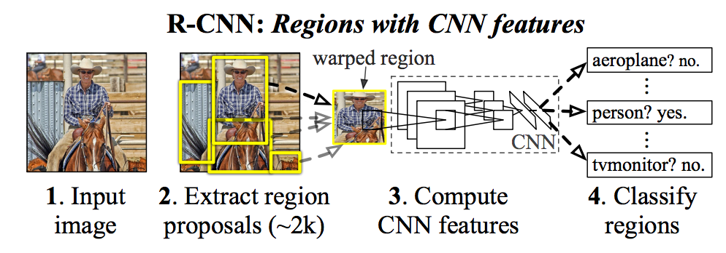
Region-Based Convolutional Neural Networks R-CNN

Slide 12
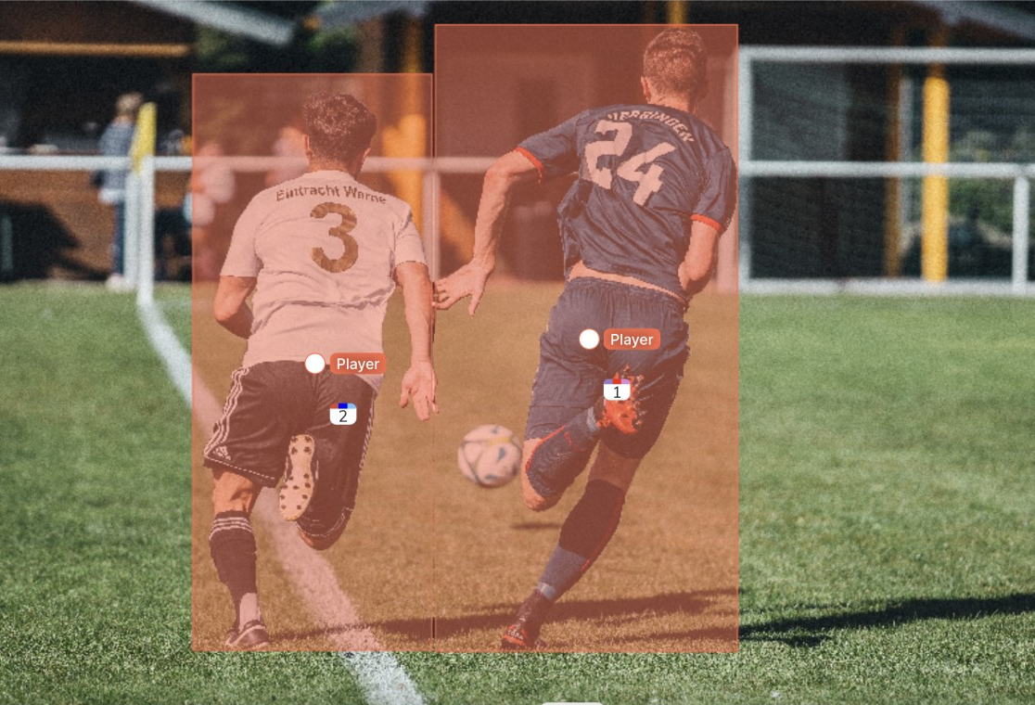
“YOLO” You Only Look Once
Quick and Accurate
One step or Two Step
Funny Name

